Slide 1
Inheritance
Raju Pal
Assistant Professor
Department of Computer Science and Engineering

Slide 2
Inheritance
Inheritance is a fundamental Object Oriented concept
On the surface, inheritance is a code re-use issue.
we can extend code that is already written in a manageable manner.
Inheritance is more
it supports polymorphism at the language level

Slide 3
Inheritance Cont…
Take an existing object type (collection of fields and methods) and extend it.
create a special version of the code without re-writing any of the existing code (or even explicitly calling it!).
End result is a more specific object type, called the sub-class / derived class / child class.
The original code is called the superclass / parent class / base class.

Slide 4
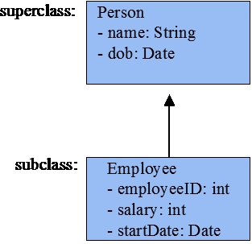
Inheritance Cont…
Inheritance uses subclasses:
A class can be defined as a "subclass" of another class.
The subclass inherits all data attributes of its superclass
The subclass inherits all methods of its superclass
The subclass inherits all associations of its superclass
The subclass can:
Add new functionality
Use inherited functionality
Override inherited functionality

Slide 5
What really happens?
When an object is created using new, the system must allocate enough memory to hold all its instance variables.
This includes any inherited instance variables
In this example, we can say that an Employee "is a kind of" Person.
An Employee object inherits all of the attributes, methods and associations of Person

Slide 6
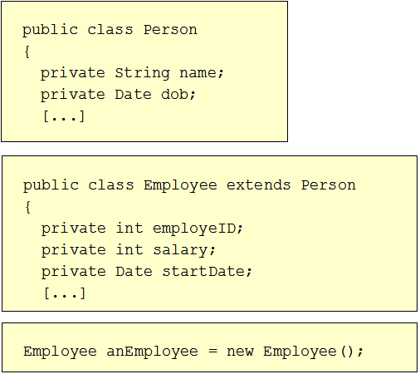
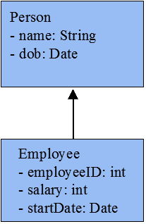
Inheritance in Java
Inheritance is declared using the "extends" keyword
If inheritance is not defined, the class extends a class called Object

Slide 7
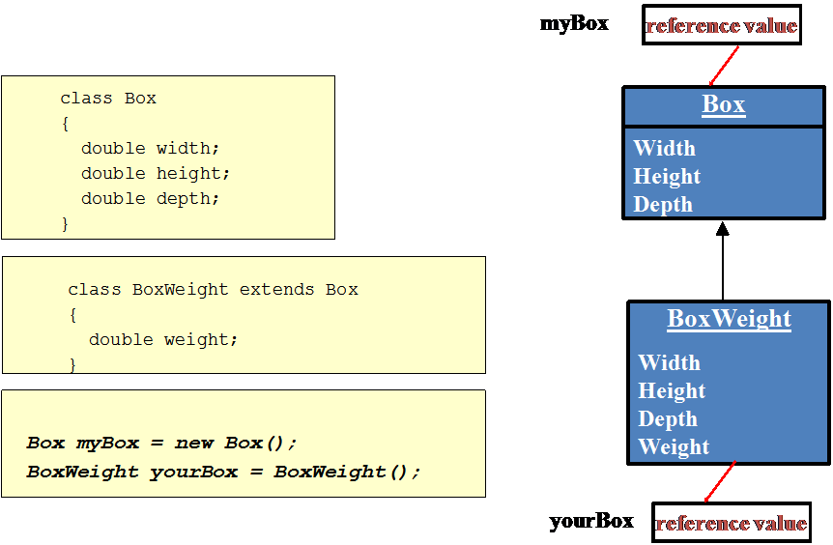
Inheritance in Java

Slide 8
Inheritance and Visibility Rules
Private variables and methods are not visible to subclasses or clients
Public variables and methods are visible to all subclasses and clients
Protected variables and methods can only be referenced by subclasses of the class and no other classes
Default variables and methods are only visible to subclasses and clients defined in the same package as the class

Slide 9
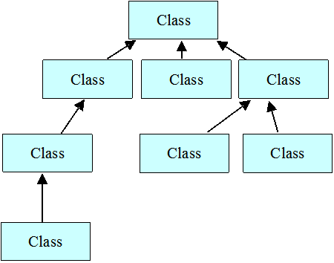
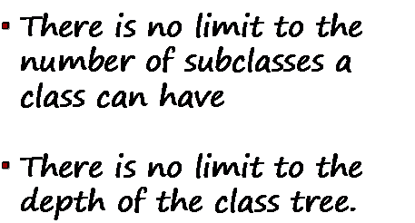
Inheritance Hierarchy
Each Java class has one (and only one) superclass.
C++ allows for multiple inheritance
Inheritance creates a class hierarchy
Classes higher in the hierarchy are more general and more abstract
Classes lower in the hierarchy are more specific and concrete

Slide 10
Types of inheritance
Single inheritance
only one super class
Multiple inheritance
several super classes
Hierarchical Inheritance
one super class, many sub classes
Multilevel Inheritance
Derived from a derived class
A
A
B
B
C
D
a) Single Inheritance
b) Hierarchical Inheritance
A
A
B
C
B
d) Multiple Inheritance
C
c) Multilevel Inheritance

Slide 11
Constructors and Initialization using super
Classes use constructors to initialize instance variables
When a subclass object is created, its constructor is called.
It also invoke the appropriate superclass constructors so that the instance variables defined in the superclass are properly initialized.
Superclass constructors can be called using the "super" keyword.
It must be the first line of code in the constructor
If a call to super is not made, the system will automatically attempt to invoke the no-argument constructor (default) of the superclass.

Slide 12
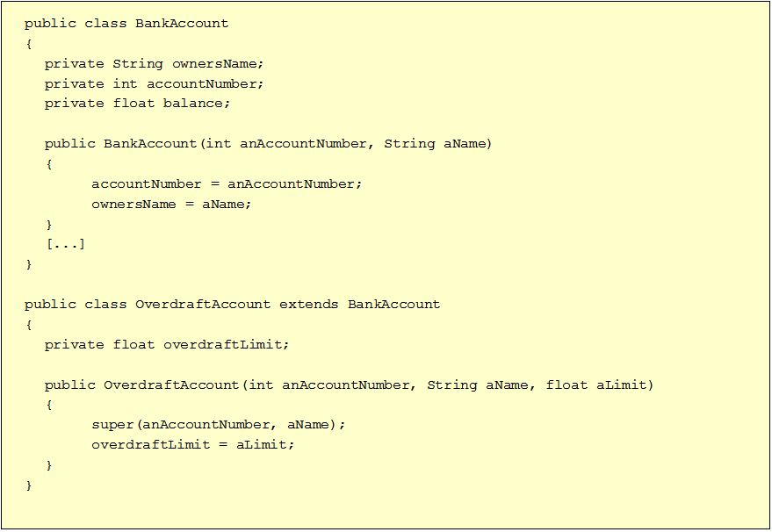
Initialization using super

Slide 13
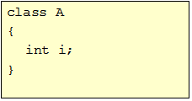
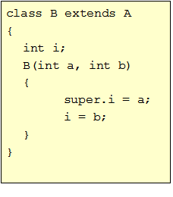
super as a member accessor
super is also used to access a member of the superclass.
Sometimes the member of superclass is hidden by the member of subclass.
The general form is:
super.member
(member = method or variable)

Slide 14
Method Overriding
Subclasses inherit all methods from their superclass
Sometimes, the implementation of the method in the superclass does not provide the functionality required by the subclass.
In these cases, the method must be overridden.
To override a method, provide an implementation in the subclass.
The method in the subclass MUST have the exact same signature as the method it is overriding.
If they are not, then the two methods are simply overloaded.

Slide 15
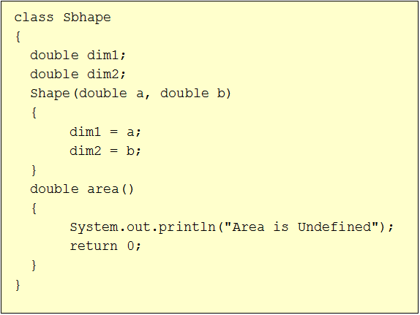
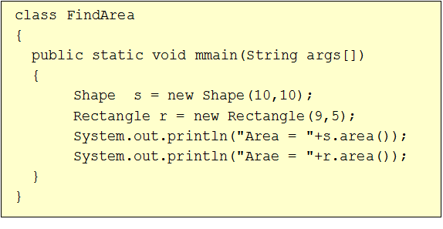
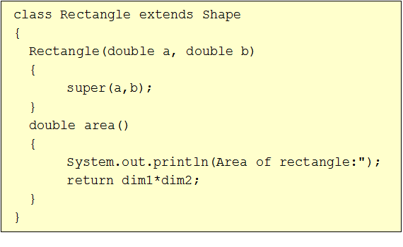
Method Overriding Example
Output:
Area is Undefined
Area = 0
Area of Rectangle:
Area = 45

Slide 16
Overriding vs Overloading
A method is overloaded if it has multiple definitions that are distinguished from one another by having different numbers or types of arguments
A method is overridden when a subclass gives a different definition of the method with the same number and types of arguments
Selection of overloaded methods is done at compile time.
Selection of overridden methods is done at run time.

Slide 17

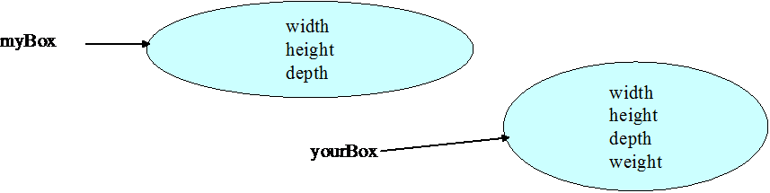
Object References and Inheritance
You can assign a subclass object reference to a variable of a superclass type.
Superclass object variable will only permit access to those items that are members of its own class.

Slide 18
Dynamic Method dispatch
(Runtime Polymorphism)
Mechanism by which a call to an overridden method is resolved at run time, rather than compile time.
A superclass reference variable can refer to a subclass object.
The version of the overridden method is selected based upon the type of the object being referred to superclass reference variable at the time the call occurs.

Slide 19
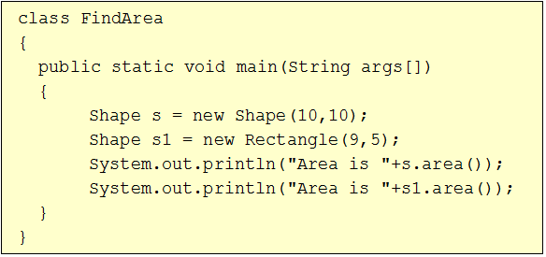
Dynamic Method dispatch Example
Output:
Area is Undefined
Area = 0
Area of Rectangle:
Area = 45

Slide 20
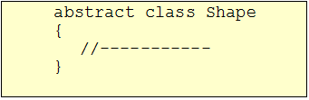
Abstract Classes
Abstract classes must contain one or more abstract methods
Abstract classes can not be instantiated
Classes are declared as abstract classes only if they will never be instantiated
Cannot declare abstract constructors, or abstract static methods
Any subclass of an abstract class must either implement all of the abstract methods in the superclass, or be itself declared abstract.
Abstract classes can be used to create object references that can be used to point to a subclass object.
Example:

Slide 21

Abstract Methods
Abstract methods have no body at all and just have their headers declared
The only way to use an abstract class is to create a subclass that implements each abstract method
Concrete classes are classes that implement each abstract method in their superclasses
Example:

Slide 22
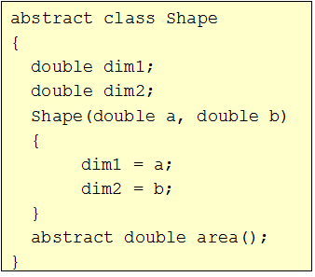
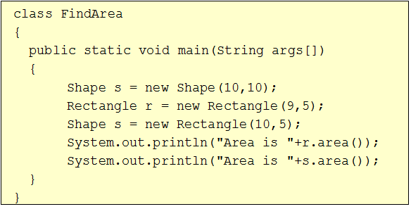
Abstract Class Example
Output:
Area of Rectangle:
Area = 45
Area of Rectangle:
Area = 50

Slide 23
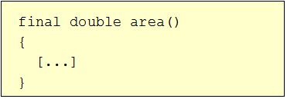
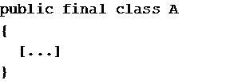
Final Methods and Final Classes
Methods can be qualified with the final modifier
Final methods cannot be overridden.
This can be useful for security purposes.
Compiler free to inline calls- improve performance
Classes can be qualified with the final modifier
The class cannot be extended
This can be used to improve performance. Because there will be no subclasses, there will be no polymorphic overhead at runtime.

Slide 24
Method Overriding
Subclasses inherit all methods from their superclass
Sometimes, the implementation of the method in the superclass does not provide the functionality required by the subclass.
In these cases, the method must be overridden.
To override a method, provide an implementation in the subclass.
The method in the subclass MUST have the exact same signature as the method it is overriding.
If they are not, then the two methods are simply overloaded.

Slide 25
Interface - Introduction
Using the keyword interface, you can fully abstract a class’ interface from its implementation.
That is, using interface, you can specify what a class must do, but not how it does it.
Methods are declared without any body.
Any number of classes can implement an interface.
One class can implement any number of interfaces. (Multiple Inheritance)
To implement an interface, a class must create the complete set of methods defined by the interface.
Interfaces are designed to support dynamic method resolution at run-time.

Slide 26
Defining an Interface
Basically a kind of class
Contains methods (only abstract methods) and variables (only final fields)
The general form of an interface:
interface interfaceName
{
type final var_name = value //variable declaration;
return-type method_name(parameter_list) //methods declaration;
}
public interface Shape
{
static final double PI = 3.142;
double area();
}

Slide 27
Defining an Interface
Methods declared have no bodies and end with a semicolon after the parameter list
Each class that includes an interface must implement all of the methods.
All variables are declared as constants.
They are implicitly final and static, meaning they cannot be changed by the implementing class.

Slide 28
Implementing an Interface
Interfaces are used as “superclasses” whose properties are inherited by classes.
Necessary to create a class that inherits the given interface
To implement an interface, include the implements clause in a class definition
Creates the methods defined by the interface
class className implements interfaceName1 [,interfaceName2..]
{
//body of the class
}
The methods that implement an interface must be declared public.

Slide 29
Implementing an Interface
public interface Shape
{
static final double PI = 3.142;
double area();
}
class Circle implements Shape
{
double area()
{
return PI*r*r;
}
}
🡪 classes that implement interfaces can define additional members of their own.

Slide 30
Accessing using Interface Reference
Can declare object reference variable of an interface.
Any instance of any class that implements the declared interface can be referred to by such an variable.
These variable can access only those members that are declared in the interface.
Provides run-time polymorphism- correct version will be called based on actual instance.
The method to be executed is looked up dynamically.

Slide 31
Interface Reference- Example
public interface Shape
{
static final double PI = 3.142;
double area();
}
class Circle implements Shape
{
double radius;
Circle(double r)
{
radius = r;
}
double area()
{
Syste.out.println(“Area of circle: “);
return PI*radius*radius;
}
}

Slide 32
Interface Reference- Example
class Rectangle implements Shape
{
double l, b;
Rectangle(double a, double b)
{
l = a;
this.b = b;
}
double area()
{
Syste.out.println(“Area of Rectangle: “);
return l*b;
}
}
class Area
{
public static void main(String args[])
{
Shape sc = new Circle(10);
Shape sr = new Rectangle(5,15);
System.out.println(sc.area());
System.out.println(sr.area());
}
}

Slide 33
Partial Implementation
Partial Implementation
It is possible that a class implementing an interface does not fully implement the methods declared by that interface
The class must be declared as abstract.
It is possible that a class implementing an interface does not fully implement the methods declared by that interface
The class must be declared as abstract.
public interface Shape
{
static final double PI = 3.142;
double area();
double volume();
}
abstract class Circle implements Shape
{
double radius;
Circle(double r)
{
radius = r;
}
double area()
{
return PI*radius*radius;
}
}

Slide 34
Accessing Interface Variables
You can use interfaces to import shared constants into multiple classes
These variables are declared by the interface.
They should initialized by some desired value.
It is as if that class were importing the constant variables into the class name space as final variables.
Example:
variable PI is used in previous code

Slide 35
Extending the Interfaces
Interfaces can be extended by some other interfaces.
Interfaces are extended using extends keyword same as classes.
public interface A
{
void meth1();
void meth2();
}
public interface B extends A
{
void meth3();
}

Slide 36
Packages-Introduction
The main feature of OOP is its ability to support the reuse of code:
Extending the classes (via inheritance)
Extending interfaces
The features in basic form limited to reusing the classes within a program.
What if we need to use classes from other programs without physically copying them into the program under development ?
In Java, this is achieved by using what is known as “packages”, a concept similar to “class libraries” in other languages.

Slide 37
Packages
Packages act as “containers” for classes.
The mechanism provided by Java for partitioning the class namespace into more manageable chunks. It is both a naming and a visibility control mechanism.
The benefits of organising classes into packages are:
The classes contained in the packages of other programs/applications can be reused.
In packages classes can be unique compared with classes in other packages. That two classes in two different packages can have the same name. If there is a naming clash, then classes can be accessed with their fully qualified name.
Classes in packages can be hidden if we don’t want other packages to access them.

Slide 38
Java Foundation Packages
Java provides a large number of classes grouped into different packages based on their functionality.
The six foundation Java packages are:
java.lang
Contains classes for primitive types, strings, math functions, threads, and exception
java.util
Contains classes such as vectors, hash tables, date etc.
java.io
Stream classes for I/O
java.awt
Classes for implementing GUI – windows, buttons, menus etc.
java.net
Classes for networking
java.applet
Classes for creating and implementing applets

Slide 39
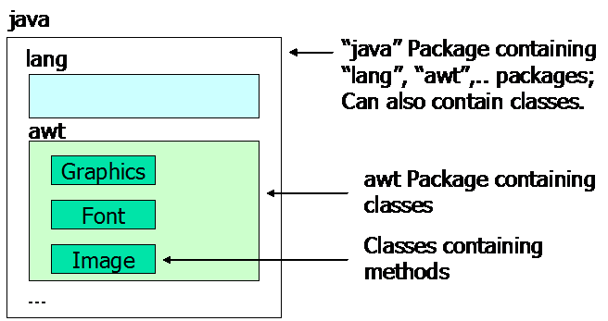
Using System Packages
The packages are organised in a hierarchical structure. For example, a package named “java” contains the package “awt”, which in turn contains various classes required for implementing GUI (graphical user interface).

Slide 40
Defining a Packages
Java supports a keyword called “package” for creating user-defined packages. The package statement must be the first statement in a Java source file (except comments and white spaces) followed by one or more classes.
The package statement defines a name space in which classes are stored.
General form – package packageName;
Example:
Package MyPackage;
Public class Example
{
//body of the class
}

Slide 41
Storage of Packages
Java uses file system directories to store packages.
Directory (folder) name in which the file is saved must match with package name.
For example, the .class files for any classes you declare to be part of MyPackage must be stored in a directory (folder) called MyPackage.
You can not rename a package without renaming the directory in which the classes are stored.
C:
Package MyPackage;
Public class Example
{
//body of the class
}
Save
MyPackage

Slide 42
Creating Sub Packages
Packages in Java are organised hierarchically, hence sub-packages can be created.
You can create a hierarchy of packages by separating them with a period.
To create sub package write the statement
General Form: package pkg1.pkg2 .pkg3;
Example:
🡪Store this file in a subdirectory named MyPackage\P1.
C:
MyPackage
Package MyPackage.P1;
Public class Example
{
//body of the class
}
P1

Slide 43
Compiling a Package class
Can compile in two following ways:
Put source file into the same directory as the package name is declared and compile the program (resulting .class file is also in same directory).
Need to create the package directory manually.
If you want to put the sourcefile and .class file at different location then use the following command (suppose source file is stored in a directory named javaPrograms. Creates package directory automatically.
C:\MyPackage>javac Example.java
C:\>javac -d ./ ./javaPrograms/Example.java

Slide 44
Finding Packages and CLASSPATH
How does the java run-time system know where to look for packages that you create?
You can specify using two methods:
First, by default the Java run-time uses the current working directory as its starting point. Thus , if package is in a subdirectory of the current directory, it will be found.
Second, you can specify a directory path or paths by setting the CLASSPATH environmental variable. CLASSPATH must point to the package’s parent directory.
C:
MyPackage
C:\> set CLASSPATH = C:\;
If you want to point the current directory then use .(dot).
More than one location can be added into the CLASSPATH
C:\abc> set CLASSPATH = .; C:\;
Java will find our class file not only from C: directory but from the current directory as well i. e. abc
P1

Slide 45
Using Packages
There are three ways of using the resources in a package:
Inline Member Declarations: declare the package member with its fully qualified package name.
Importing a Single Package Member: Easily achieved using an import statement in which the import keyword is followed by the fully qualified name of the member you wish to use.
Importing an Entire Package: It may be that you use a number of members from a package and end up with a large number of import statements. . Put asterisk (*) in the place of member Name

Slide 46
Using Packages
Inline Member Declarations: declare the package member with its fully qualified package name.
Importing a Single Package Member: Easily achieved using an import statement in which the import keyword is followed by the fully qualified name of the member you wish to use.
Public class Test
{
MyPackage.Example example = new MyPackage.Example();
}
import MyPackage.Example;
Public class Test
{
Example example = new Example();
}

Slide 47
Using Packages
Importing an Entire Package: It may be that you use a number of members from a package and end up with a large number of import statements. . Put asterisk (*) in the place of member Name in import statement.
🡪import statements occur immediately following the package statement (if it exists) and before any class definitions
import MyPackage.*;
Public class Test
{
Example1 example1 = new Example1();
Example2 example2 = new Example2();
}

Slide 48
Using Package
All of the standard Java classes included with Java are stored in a package called java.
The basic language functions are stored in a package inside of the java package called java.lang. Since Java is useless without much of the functionality in java.lang, it is implicitly imported by the compiler for all programs.
If a class with the same name exists in two different packages that you import using the star form, the compiler will remain silent, unless you try to use one of the classes.
You will get a compile time error and have to explicitly name the class specifying its package.

Slide 49
Protection and Packages
All classes (or interfaces) accessible to all others in the same package.
Class declared public in one package is accessible within another. Non-public class is not
Members of a class are accessible from a difference class, as long as they are not private
protected members of a class in a package are accessible to subclasses in a different class

Slide 50
Visibility - Revisited
Public keyword applied to a class, makes it available/visible everywhere. Applied to a method or variable, completely visible.
Private fields or methods for a class only visible within that class. Private members are not visible within subclasses, and are not inherited.
Protected members of a class are visible within the class, subclasses and also within all classes that are in the same package as that class.

Slide 51
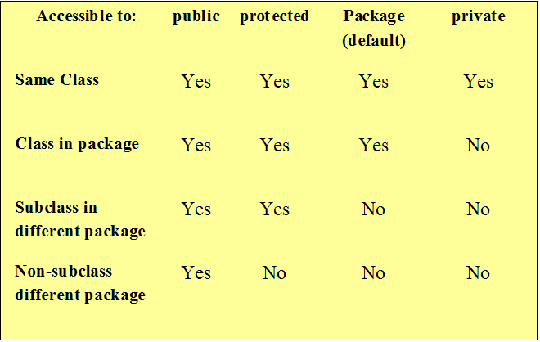
Visibility Modifiers

Slide 52
Package Example
package P1;
public abstract class Shape
{
public double PI = 3.14;
public double area();
}
package P2;
import P1.*;
public class Rectangle extends Shape
{
public double l,b;
public Rectangle(double l, double b)
{
this.l = l;
this.b = b;
}
public double area()
{
return l*b;
}
}
package P1;
public class Circle extends Shape
{
public double radius;
public Circle(double r)
{
}
public double area()
{
return PI*radius*radius;
}
}

Slide 53
Package Example
Save Shape and Circle class in P1 directory.
Save Rectangle in P2 directory.
import P1.*;
import P2.*;
public class Area
{
public static void main(String args[])
{
Circle c = new Circle(10);
Rectangle r = new Rectangle(15,10);
System.out.println(“Area : “+c.area());
System.out.println(“Area : “+r.area());
}
}

Slide 54
Thank you !!

